Slide 1
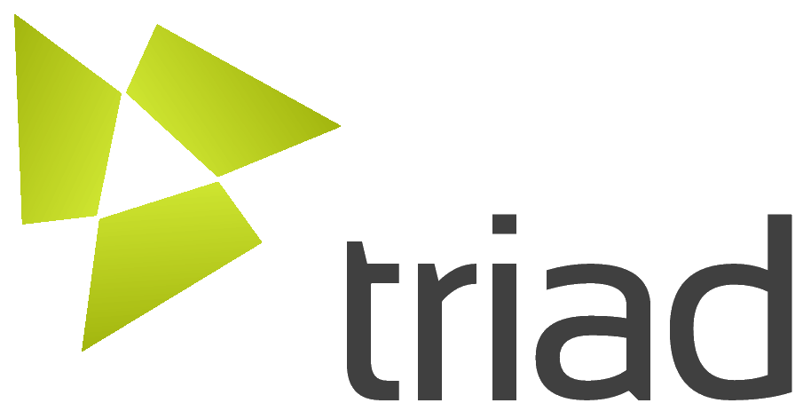
Adaptation and Adoption of caBIG tools to a
clinical research community
David Ervin, Sreekant Lalokta, Puneet Mathur, Rakesh Dhaval, Calixto Melean, Omkar Lele, Tara Payne, Philip R. O. Payne, Ph.D.
Center for IT Innovation in Healthcare, Department of Biomedical Informatics, The Ohio State University
Abstract
Methods
Results
The Ohio State University Clinical and Translational Science Award (CTSA) is addressing the need to collect, store, integrate, analyze, and report upon heterogeneous and distributed data sets spanning organizational boundaries. This is accomplished by a grid middleware and tooling system known as TRIAD.
TRIAD addresses the needs and challenges presented by multi-institutional translational team science by allowing for the creation of a scalable, secure, and knowledge anchored data sharing environment. TRIAD builds upon and extends the robust caGrid[1] infrastructure that was initially designed for the National Cancer Institute’s caBIG program.
TRIAD seeks to integrate disparate clinical data sources into a common grid environment. By doing so, researchers maintain locus of control over their research while expanding the scope, capability, and quality of research and knowledge made available to the broader TRIAD adopter community. TRIAD accelerates the pace of research by providing the means to create knowledge centered pipelines and facilitating cross-institutional data queries.
Specialized adapters have been created within TRIAD to enable use of common data gathering and storage tools such as REDCap and i2b2 within the existing grid infrastructure. By approaching data sharing from the perspective of a wrapper around an existing tool rather than a monolithic and large engineering effort, researchers and clinicians may readily and rapidly move to interconnected grid systems.
A major benefit of TRIAD is the ability to allow researchers or institutions to maintain control of their own data and decide with whom and in what contexts it is shared. As such, TRIAD makes research data management and hypothesis testing more efficient by bringing disparate data and systems together, ultimately moving science forward by enabling researchers to ask and answer impactful and timely questions.
Nationwide Children's Hospital and The Ohio State University Medical Center are participating in the Ohio Perinatal Research Network (OPRN) and using TRIAD to break down institutional barriers to improve quality of care for at-risk infants. A virtually integrated perinatal research repository comprised of clinical data and specimens from mothers and their infants will support the OPRN, and provide information to collaborating OPRN researchers and institutions
The Ohio State University is collaborating with the Human Studies Database Project (HSDB) to accelerate adoption and interoperability of the Human Studies model known as the Ontology of Clinical Research (OCRe). HSDB aims to standardize the storage model for the designs and discoveries of human studies, with the ultimate goal of accelerating analysis across studies, data mining, and reuse
TRIAD is connecting disparate information between the institutional Information Warehouse and the biospecimen banking repository which leverages the caTissue tool to provide researchers with a rich way to rapidly discover cohorts of patients and tissue samples. To address this disconnect, TRIAD has undertaken a project to expose the IW and caTissue data sources as specialized grid data services, and then apply both existing and new grid tooling and application interfaces.
The TRIAD data service creation workflow extensively leverages the openMDR, a federated ISO 11179 metadata repository[2] developed with the express purpose of enabling institutions to develop and maintain their own unique semantic library while
Background
The need to collect, store, integrate, analyze, and report upon heterogeneous and distributed data sets spanning organizational boundaries is one of the most common informatics needs found in multidisciplinary and team-based clinical and translational research programs. Examples of the informatics challenges that are often experienced in this regard include:
Physically disparate community participants.
Multi-institutional security and data interoperability issues.
Training and change-management overhead.
Complex federal and local data integrity and privacy constraints.
TRIAD addresses these needs and challenges by allowing for the creation of a scalable, secure, and knowledge anchored data sharing environment, building upon the robust caGrid infrastructure that was initially designed for the National Cancer Institute’s caBIG program. Researchers can utilize TRIAD to discover, retrieve, and integrate data and knowledge sources related to their research from multiple systems (e.g., data warehouses, project-specific databases, bio-specimen repositories, etc.), often across multiple institutions, with a single query.
References
interoperating with repositories and systems. This enables researchers to create, curate, and iteratively build their own data models specific to their problem domain without a large administrative burden. Simple, powerful tools for querying the openMDR and annotating models directly in the tools which create them make the TRIAD data service creation workflow streamlined and agile.
TRIAD additionally provides wrappers to bring varied data sources to the grid using the standardized query interface which enables interoperability with existing grid tooling and federated data retrieval through a common query language. Such wrappers have been developed for REDCap and i2b2, enabling researchers to bring forms-based data capture and performant clinical data stores to the grid.
1: Oster, S. et al., (2007), "caGrid 1.0: An Enterprise Grid Infrastructure for Biomedical Research", Journal of the American Medical Informatics Association, Vol. 15(2): pp.138-149.
2: Dhaval, R. et al., “Development of an Extensible Knowledge Management Infrastructure for the Translational Research Informatics and Data Management Grid (TRIAD)”, Poster session presented at American Medical Informatics Association, annual symposium; 2009 Nov 14-18; San Francisco, CA
Please see http://triadcommunity.org
for more information
The project described was supported by Award Number UL1RR025755 from the National Center For Research Resources

